Slide 1
Mood-Based Classifier and Recommender System
Final Project Presentation
Group-41

Slide 2

Motivation Video

Slide 3
Motivation
Music deeply resonates with our emotions, yet choosing a song to match one's mood in today's vast digital library is daunting. Most platforms only suggest based on user history, neglecting the emotional aspect. Our project offers a Mood-Based Song Classifier and Recommender System, using machine learning to discern moods from recent song choices. We aim for a personalized listening experience, bridging the gap between emotions and song recommendations. Our goal is to align every song suggestion with the user's emotional state.

Slide 4
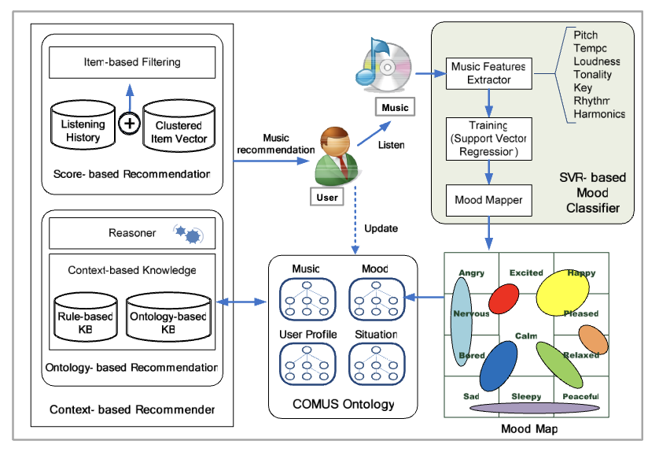
Literature Review
SVR-based music mood classification and context-based music recommendation by Seungmin Rho , Byeong-jun Han and Eenjun Hwang.
This paper focuses on context based
music recommendation. The authors
first classified the mood after converting
it into a regression problem based on
Support Vector Regression (SVR).For music
recommendation, they assess the user’s
mood and situation using both
collaborative filtering and ontology
technology.

Slide 5
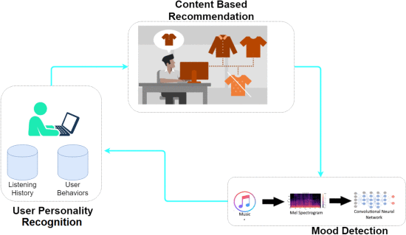
Literature Review
Moodplay: Interactive Mood-based Music Discovery and Recommendation by Ivana Andjelkovic, Denis Parra, John O’Donovan.
MoodPlay is a hybrid recommender system music which integrates content and mood-based filtering in an interactive interface. MoodPlay allows the user to explore a music collection by latent affective dimensions, by integrating user input at recommendation time with predictions based on a pre-existing user profile.
An Emotional Recommender System for Music by Vincenzo Moscato, Antonio Picariello and Giancarlo Sperli.
In this paper, the authors describe a novel
music recommendation technique based on
the identification of personality traits, moods,
and emotions of a single user. It embeds
users’ personality and mood with a content
-based filtering approach to obtain accurate
and dynamic results.

Slide 6
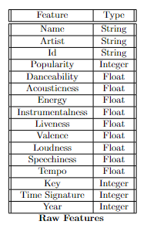
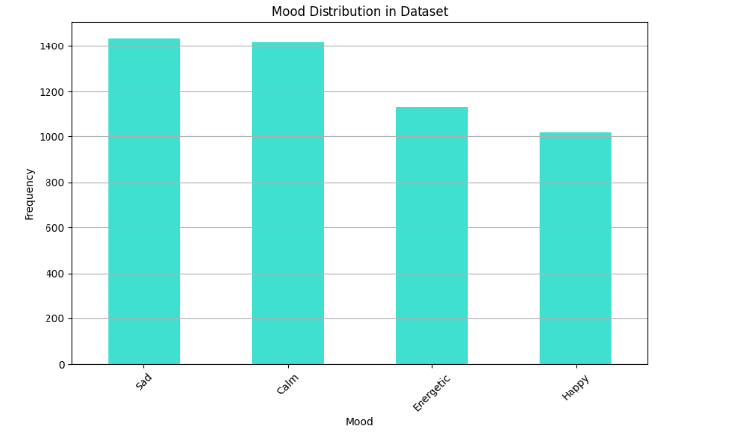
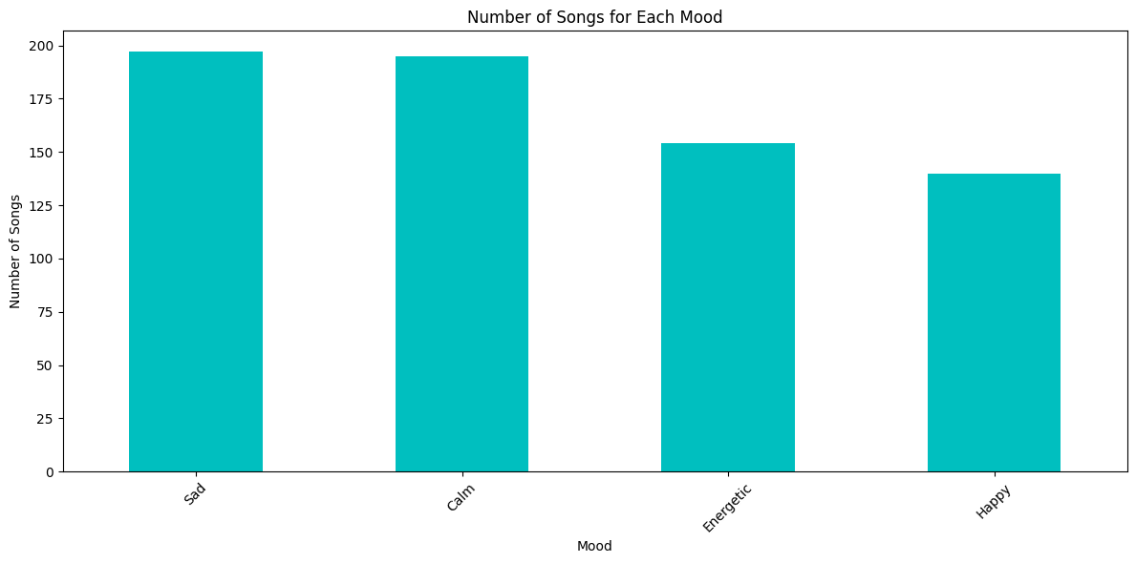
Dataset Description
We used the Spotify Music data [LINK] which contains songs from different artists and multiple genre. All the songs features were extracted using Spotify API.
We have populated the data for the recommender system to 2501 songs.
New data
Old Data

Slide 7
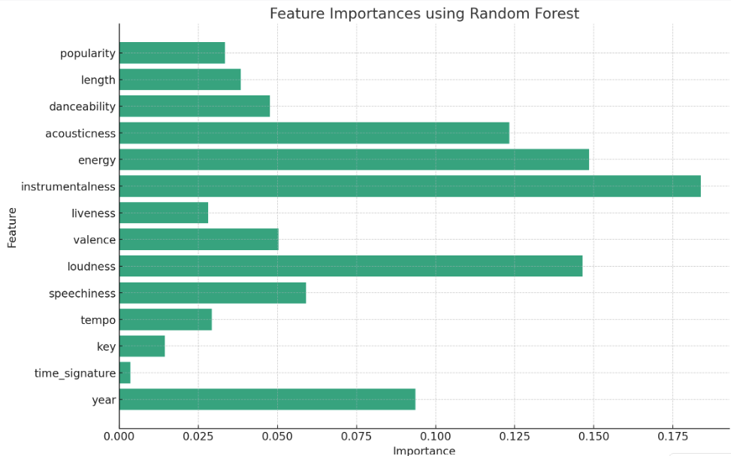
DataSet Preprocessing
Categorical Features such as name, artist, and id are dropped.
Numerical Features are standardised to ensure they have a mean of 0 and a standard deviation of 1.
Label encoding of categorical target label mood.
Feature Selection has been been done using Random Forest and based on the avg. impurity loss time signature and key are dropped.

Slide 8
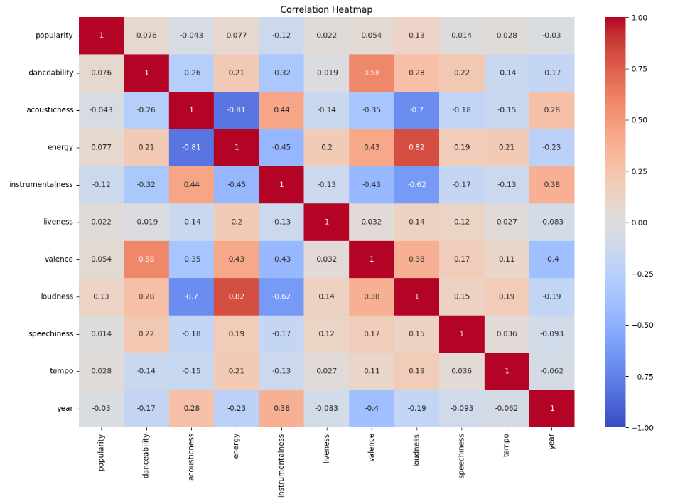
Dataset Visualisation
Positive Correlation:
Energy and Loudness
Negative Correlation: Acousticness and Energy

Slide 9
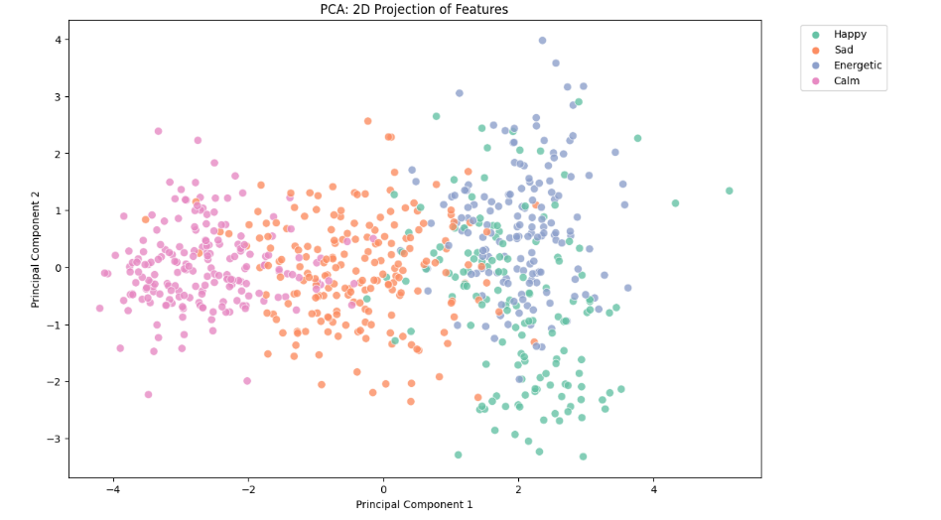
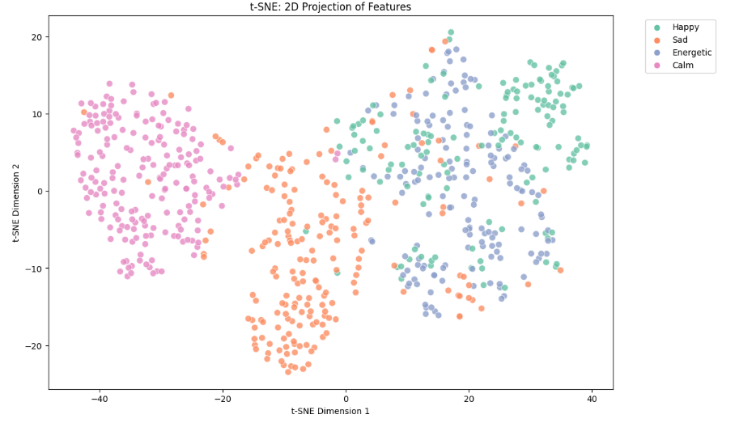
Data Visualization
Dimensionality Reduction
Principal Component Analysis
T-distributed Stochastic Neighbor Embedding
Moods are clearly separable (in separate clusters) except for energetic and happy songs, where there is a some amount of overlap.

Slide 10



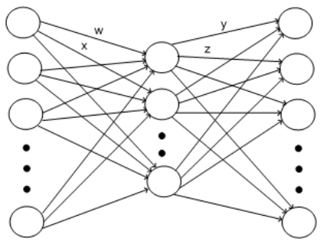


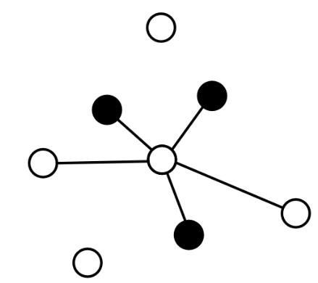
Methodology
Classifier Models Tested
Logistic Regression
Gaussian Naive Bayes
Decision Tree
ANN
Random Forest
XGBoost Classifier
Support Vector Machine
Linear
Polynomial
RBF
KNN

Slide 11
Recommender System
First input user’s listening history during a session in list format and specific number of song recommendations needed.
Then our system computes the average values across 11 musical features like the valance, danceability, from the user’s session playlist. This average is then used as input for the XGBoost classifier to infer the user’s current mood.
The system computes the average values across 11 musical features like the valance,danceability, etc. from the user’s session playlist. This average is then used as input for the XGBoost classifier to infer the user’s current mood.
With the mood determined , we now start searching the songs for the user.
To achieve this, we employed a Euclidean search technique, identifying songs that closely match the computed average feature values and ensuring that finding is done in such a way around that the mood of these songs aligns with the inferred mood of the user in Classifier.

Slide 12
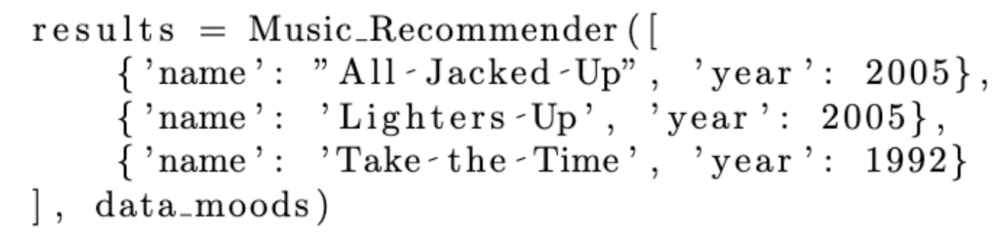
Recommender System - Working
3 Songs are input to the Recommender System

Slide 13
Recommender System - Working
3 Songs are input to the Recommender System
Average is calculated for all the 11 features and then determined the mood of the user by it.
[[ 0.25178567 -0.29098346 -0.93822972 1.08701203 -0.84986594 -0.33774234
1.08108242 0.66089143 3.89387694 0.57020192 -0.9529511 ]]
Model Classifies the mood as Energetic

Slide 14
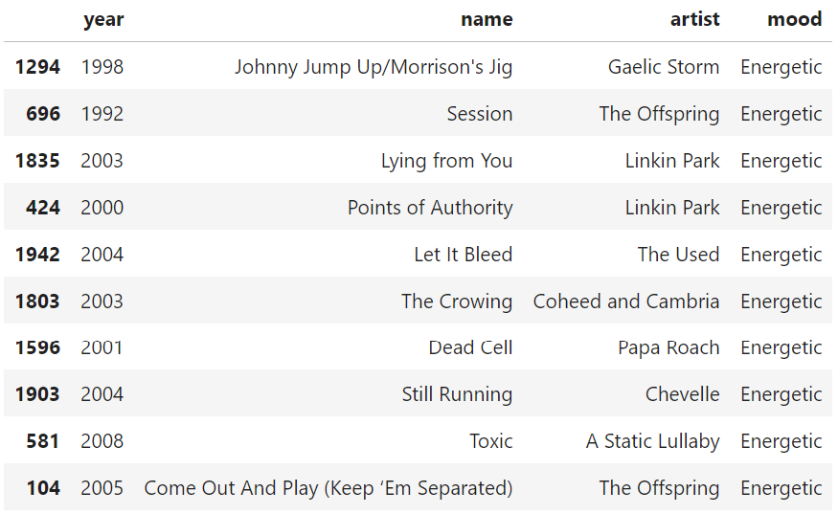
Recommender System - Working
3 Songs are input to the Recommender System
Average is calculated for all the 11 features and then determined the mood of the user by it.
Model Classifies the mood as Energetic
Recommendations based on Euclidean Distance

Slide 15


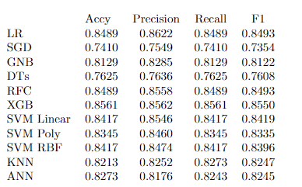
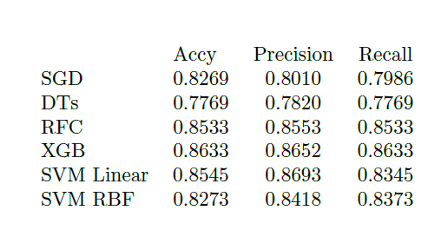
Results and Analysis
We selected Gaussian Naive Bayes and Decision Tree as the baseline models because of their minimal complexity.
We tested the models listed below and obtained the metrics before and after hyperparameter tuning with cross-validation (k=10).
Decision Trees, in particular, showed noticeable improvement after hyperparameter tuning, emphasizing the value of tuning especially for models with numerous parameters like trees.
SVM (both Linear and RBF kernel) also improved, suggesting that the default hyperparameters were not optimal for this dataset.

Slide 16
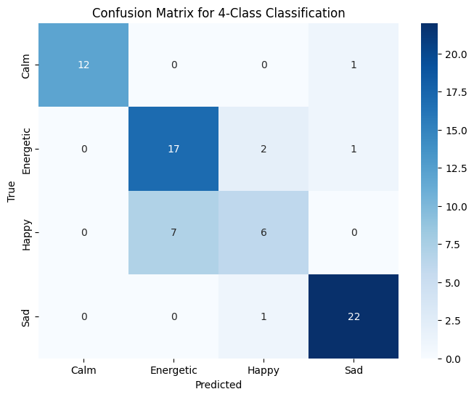
Results and Analysis
After hyper parameter tuning with cross-validation, we notice an improvement in the evaluation metrics of Random Forest , SVM, Decision Tree and SGD Classifier. There was no improvement in the evaluation metrics of the XGB model as it is already optimised.
We get the best results from
XGBoost Classifier and Random
Forests with accuracies of 86.31%
and 85.33% respectively.
This is because ensemble models
like Random Forest and XGB have
higher accuracy and F1 scores
compared to simpler models, given
their ability to capture complex
relationships and reduce overfitting.

Slide 17
Conclusion
We have discovered that the features we've used are highly effective in discerning the mood of a song, and as a result, they can effectively represent the mood of the listener. The XGB Classifier model has yielded a promising metric score.
We have implemented a recommender which based on the given input, classifies the mood and analyze users' music preferences and offers personalized song recommendations that are both sonically compatible and emotionally resonant.

Slide 18
Recommender System Demo
Link: https://www.kaggle.com/harshparimalpopat/final-ml-project

Slide 19
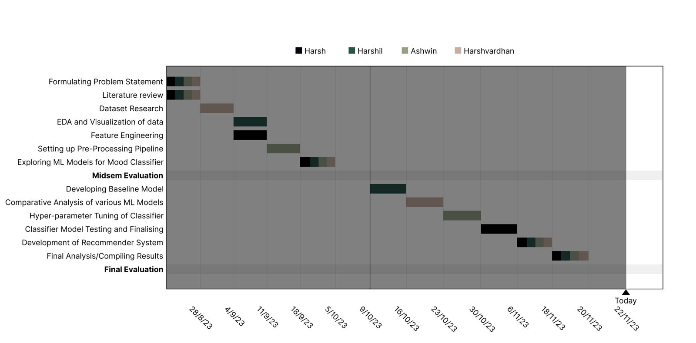
Timeline
Completed ALL the work according to the timeline

Slide 20
Individual Contribution
Ashwin R Nair
Setting Up and Designing a robust pre-processing pipeline, ensuring data cleaning,feature scaling, and encoding for optimal model performance. Implemented techniques to handle missing values and outliers, enhancing data quality.
Harsh Popat
Enhancing model predictive power by feature selection and hyperparameter used to improve model performance and help to get valuable insights from the data.
Harshil Mital
Performing Exploratory Data Analysis (EDA). Also, experimented with various ML models and conducting performance evaluations, leading to the selection of the most suitable algorithms.
Harshvardhan Singh
Did literature review on related research to inform data selection and model design, ensuring the project’s foundation is built on sound empirical and theoretical knowledge. Explored Various ML models to get familiar with the available techniques.

Slide 21
THANK YOU!
Ashwin R Nair (2020037)
Harsh Parimal Popat (2021048)
Harshil Mital (2021050)
Harshvardhan Singh (2021052)

